Slide 1
BOREWELL CHILD RESCUER

Slide 2
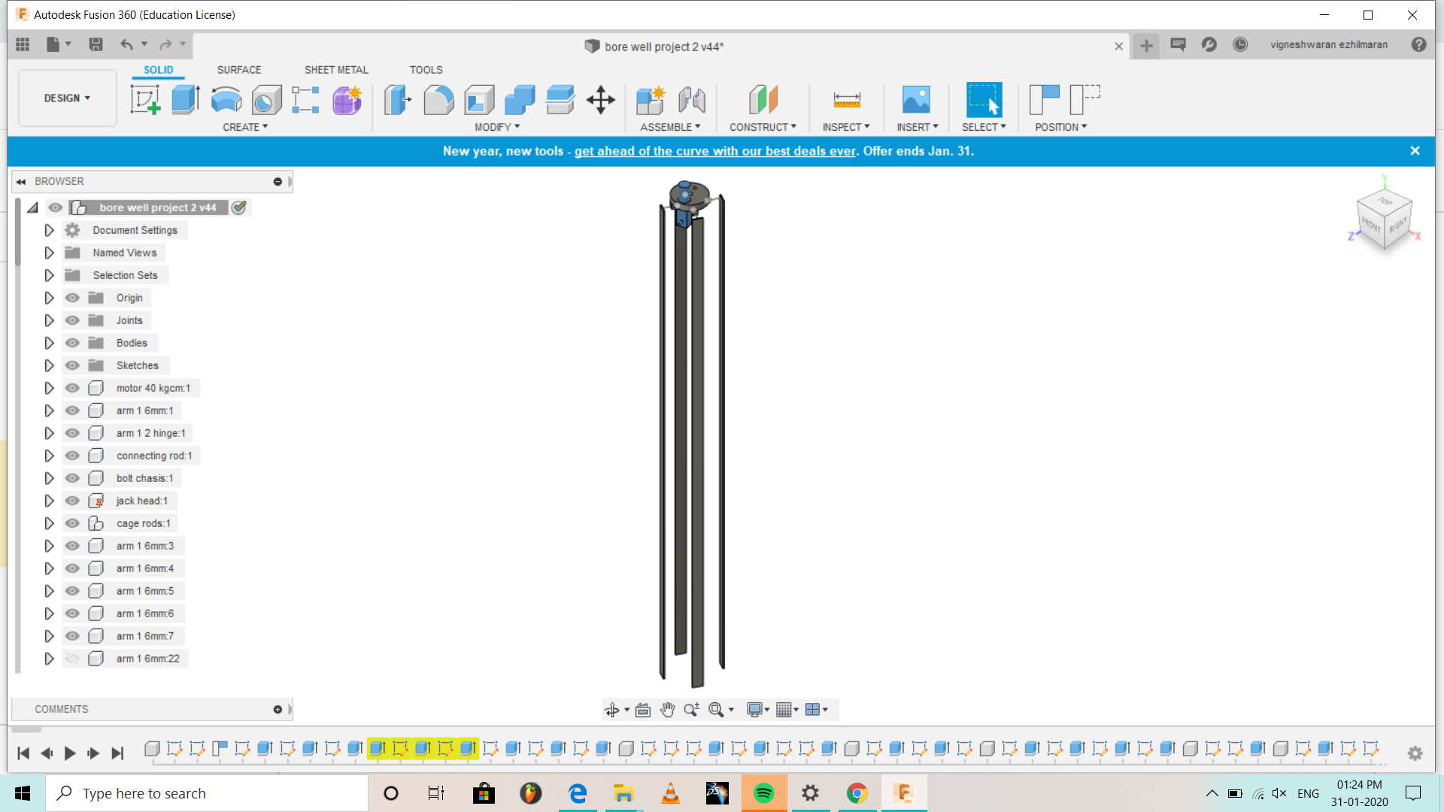
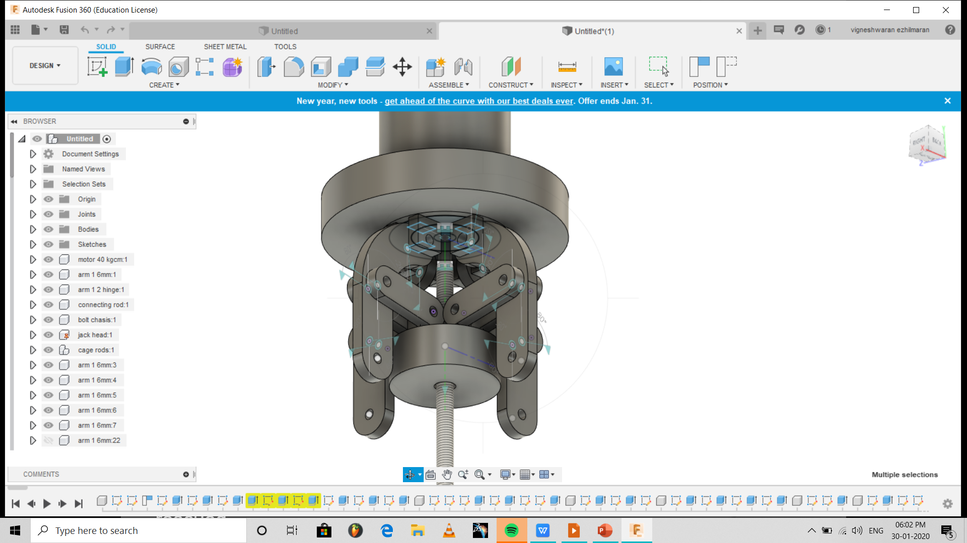
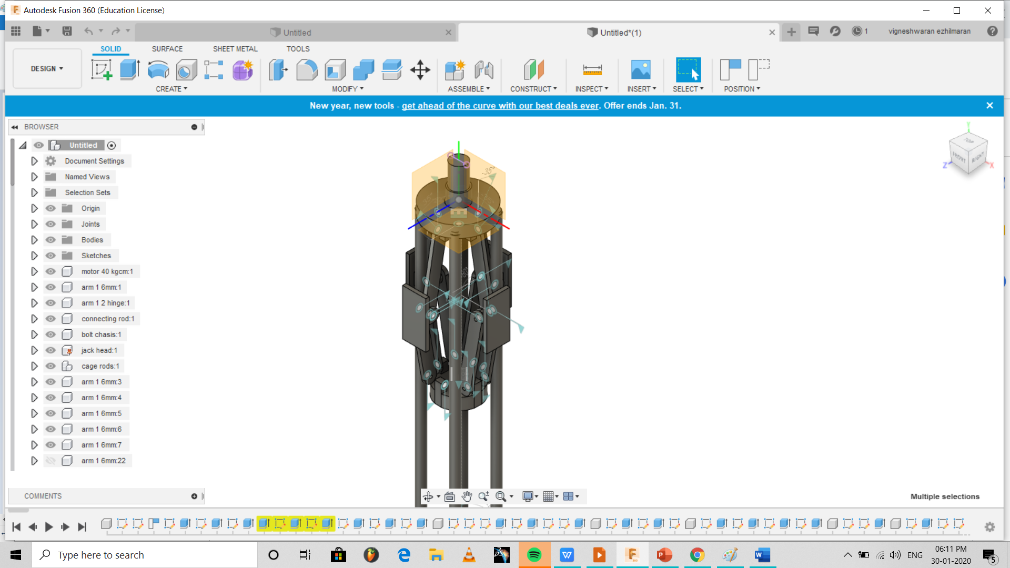
Design
Holds on to the walls of the bore well
Cage structure
Grips head to prevent slipping

Slide 3
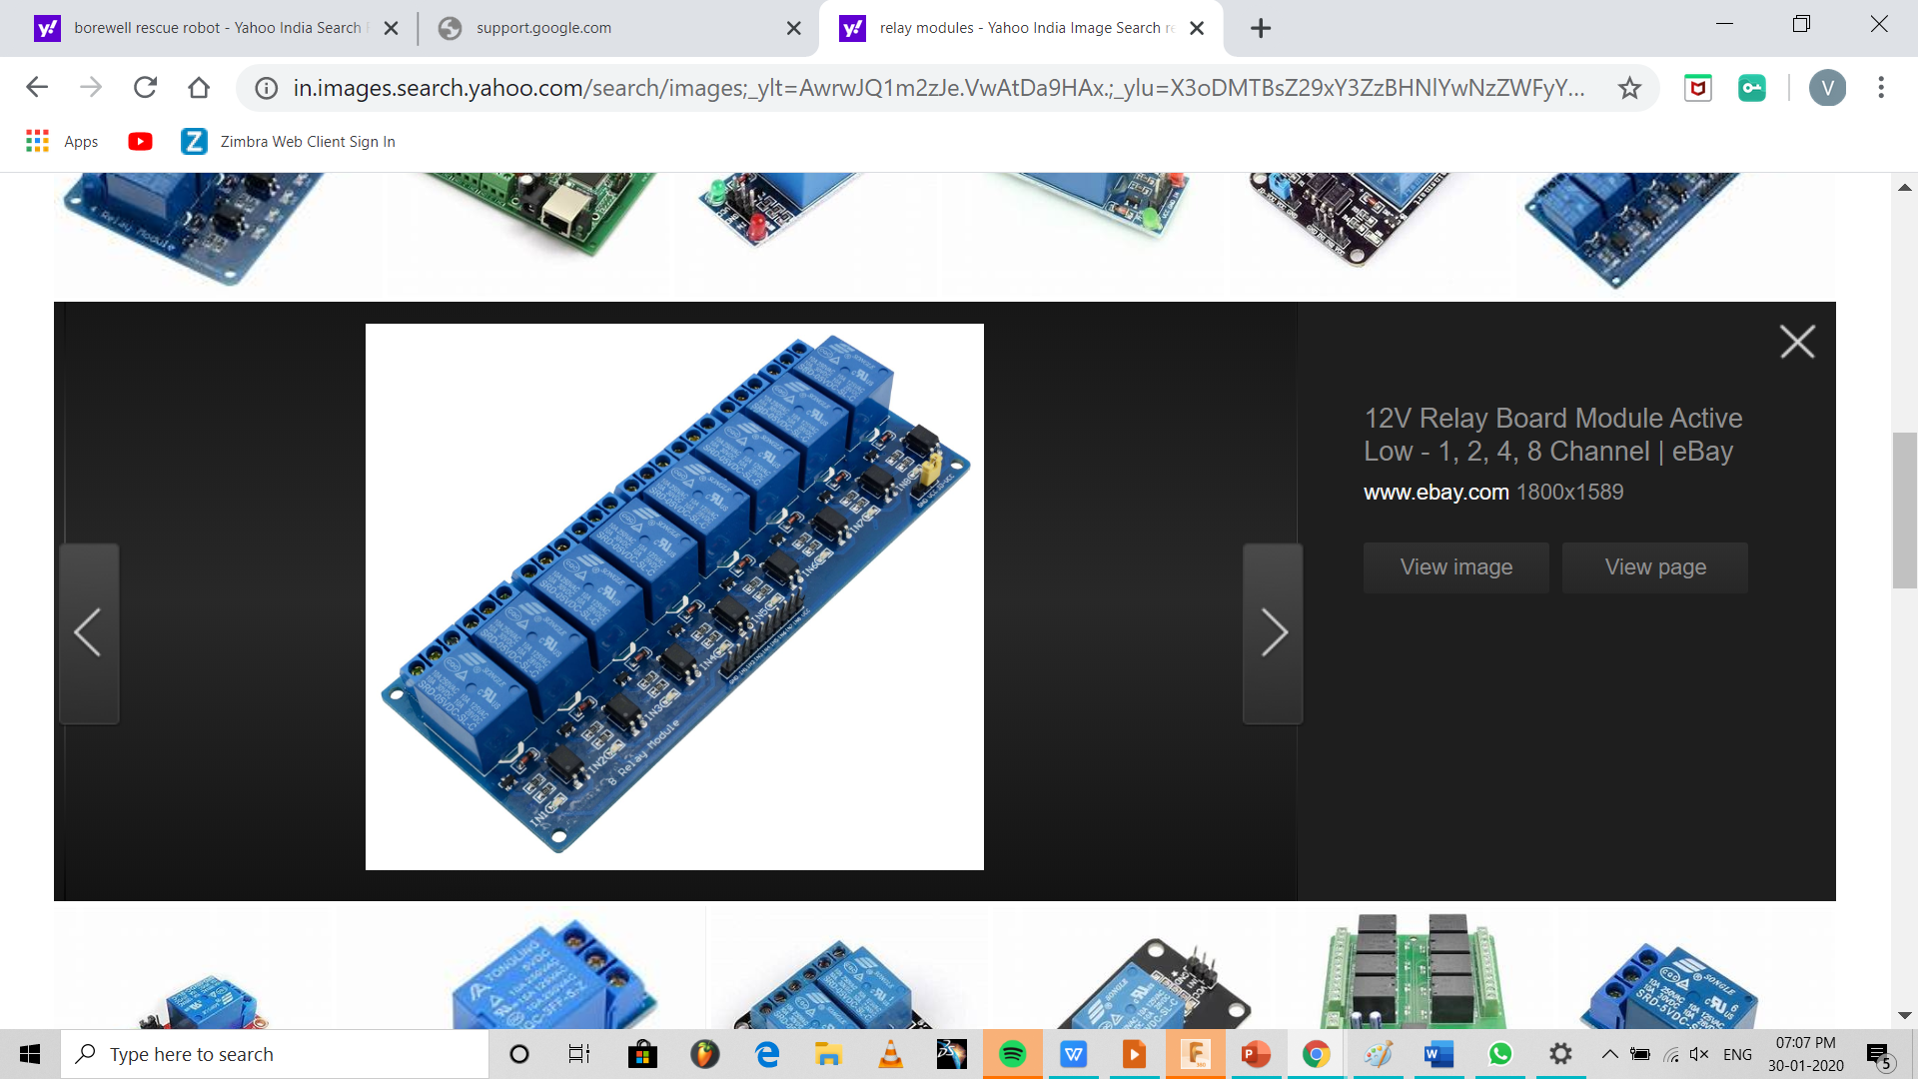
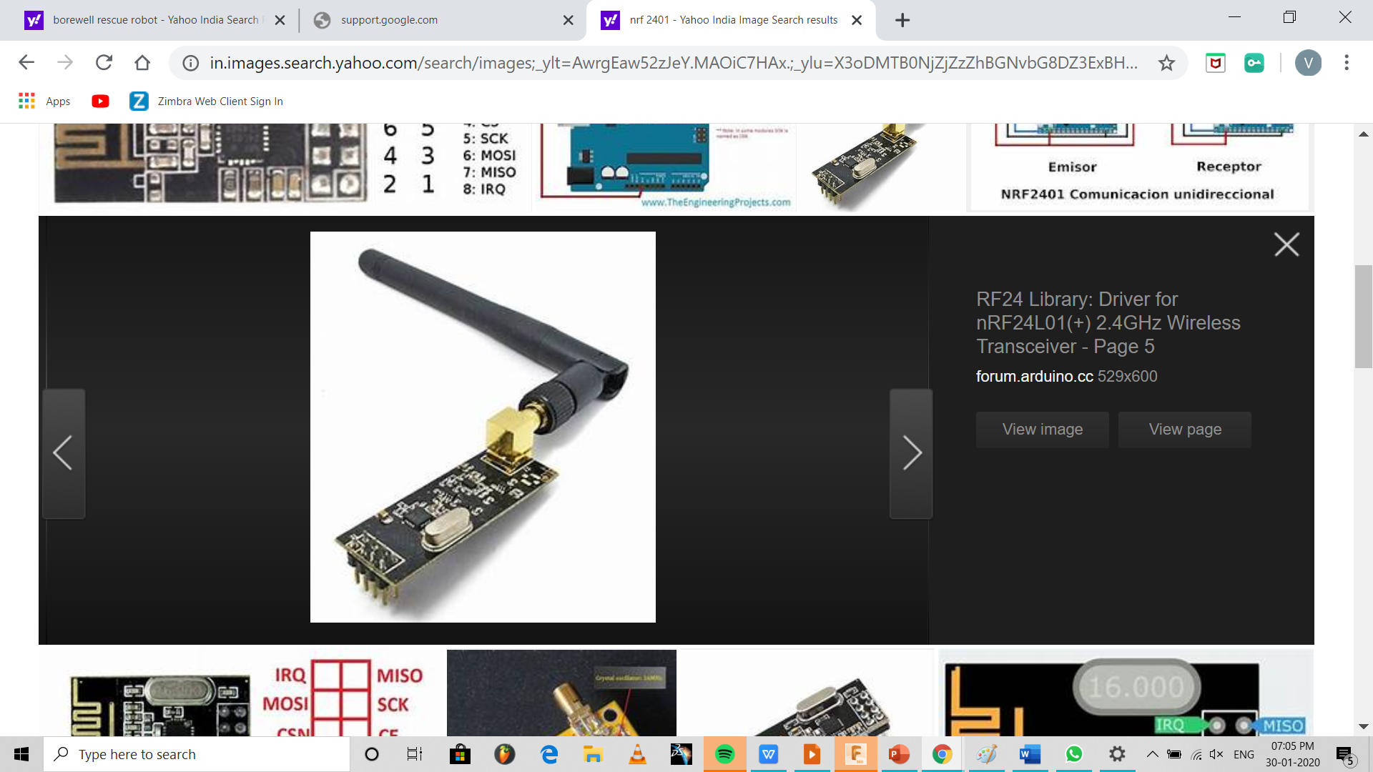
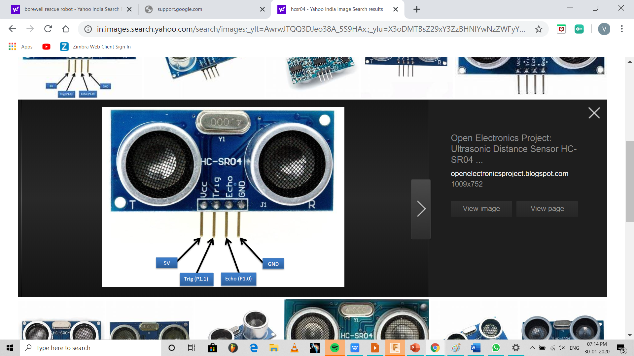
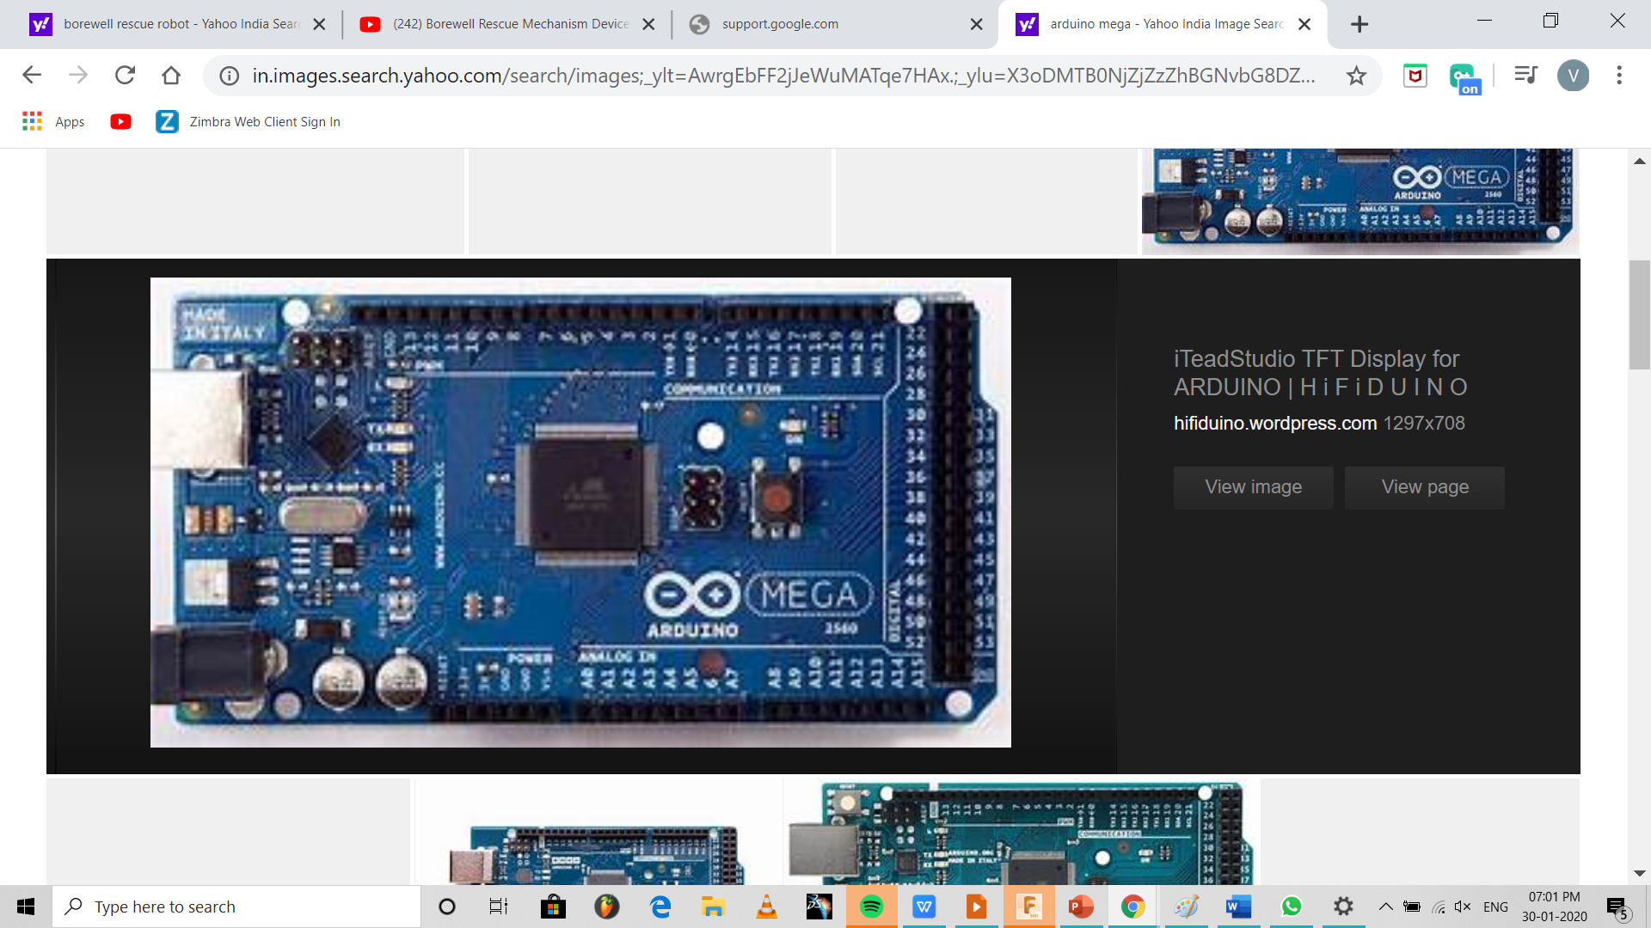
ELECTRONIC COMPONENTS:
Arduino MEGA 2560
NRF 2401
Relay module
HC-SR04

Slide 4
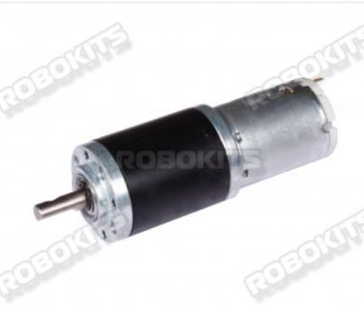
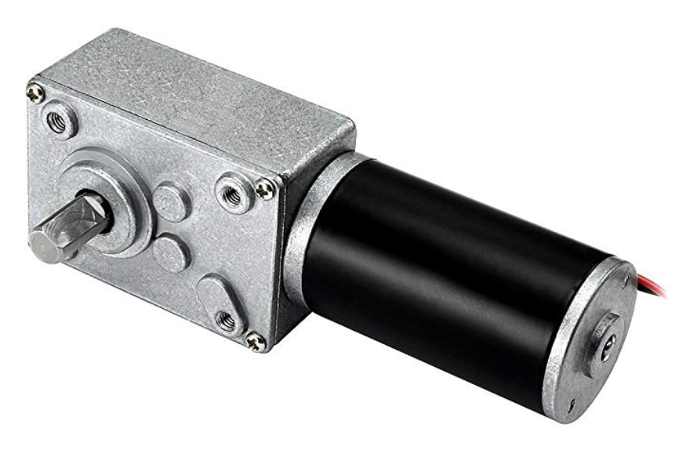
ELECTRICAL COMPONENTS:
PLANETARY GEAR MOTOR
WORM GEAR MOTOR
Torque-70kgcm
Rpm- 30
Load current- 6 amps
Voltage - 12V
Torque- 40kgcm
Rpm- 3
Load current- 4 amps
Voltage -12

Slide 5
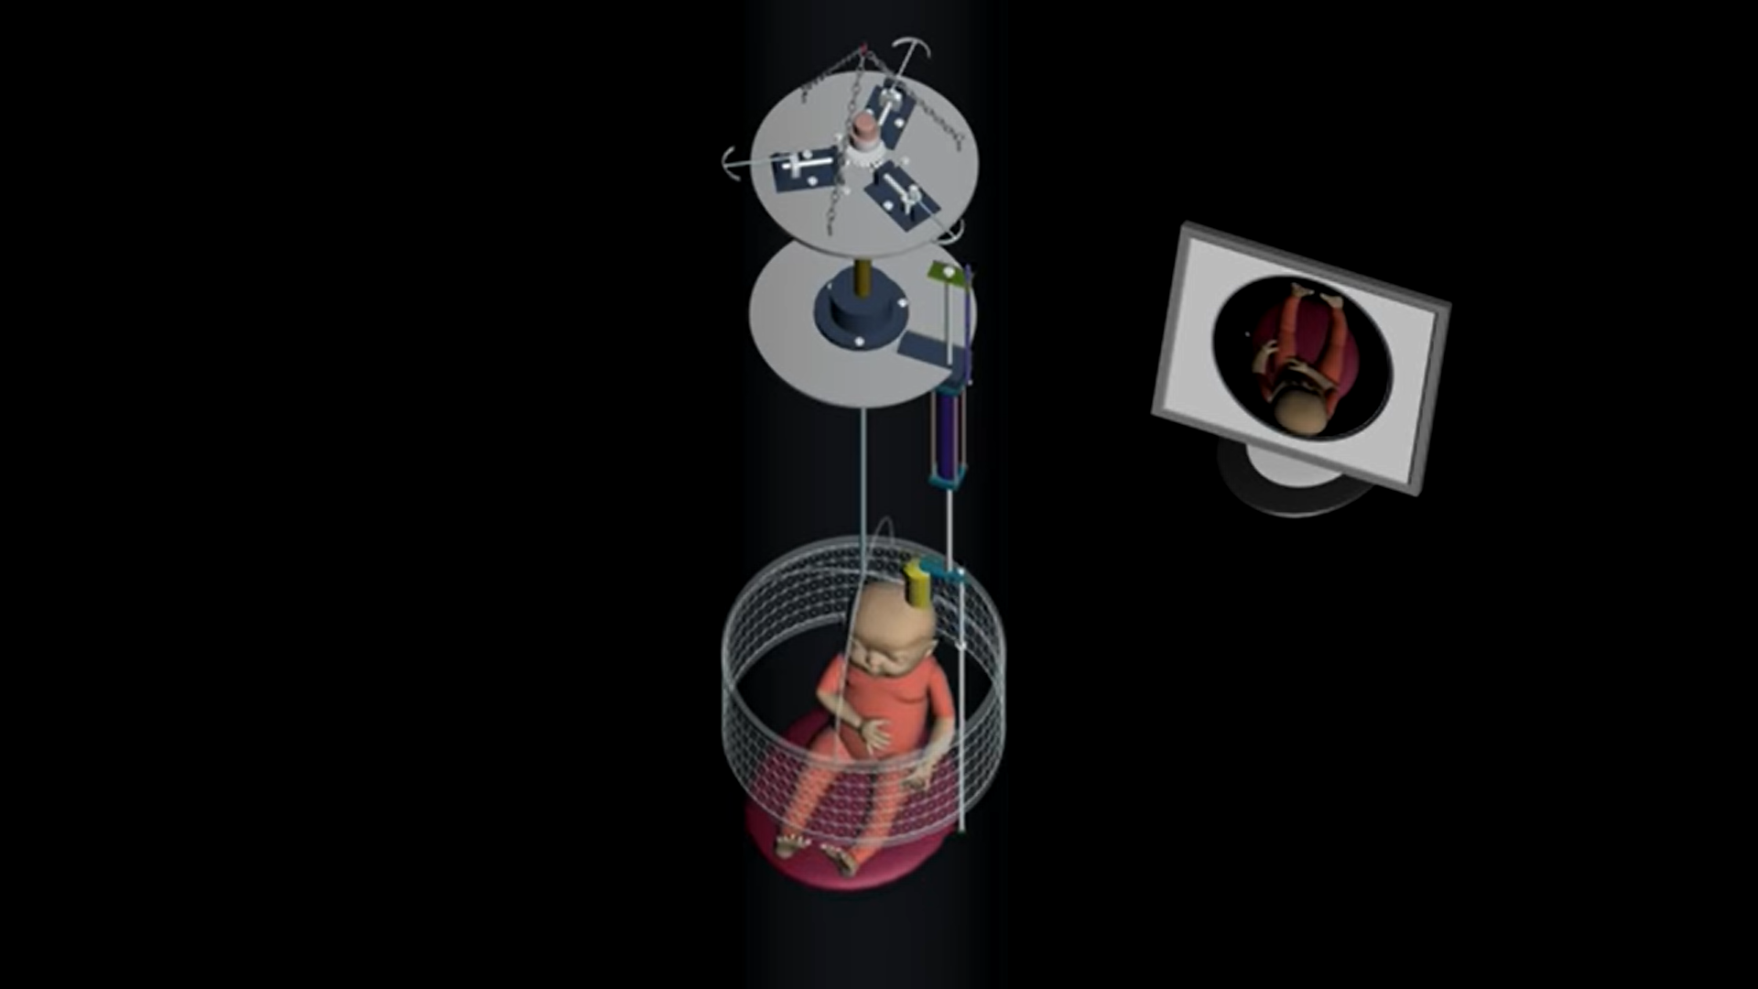
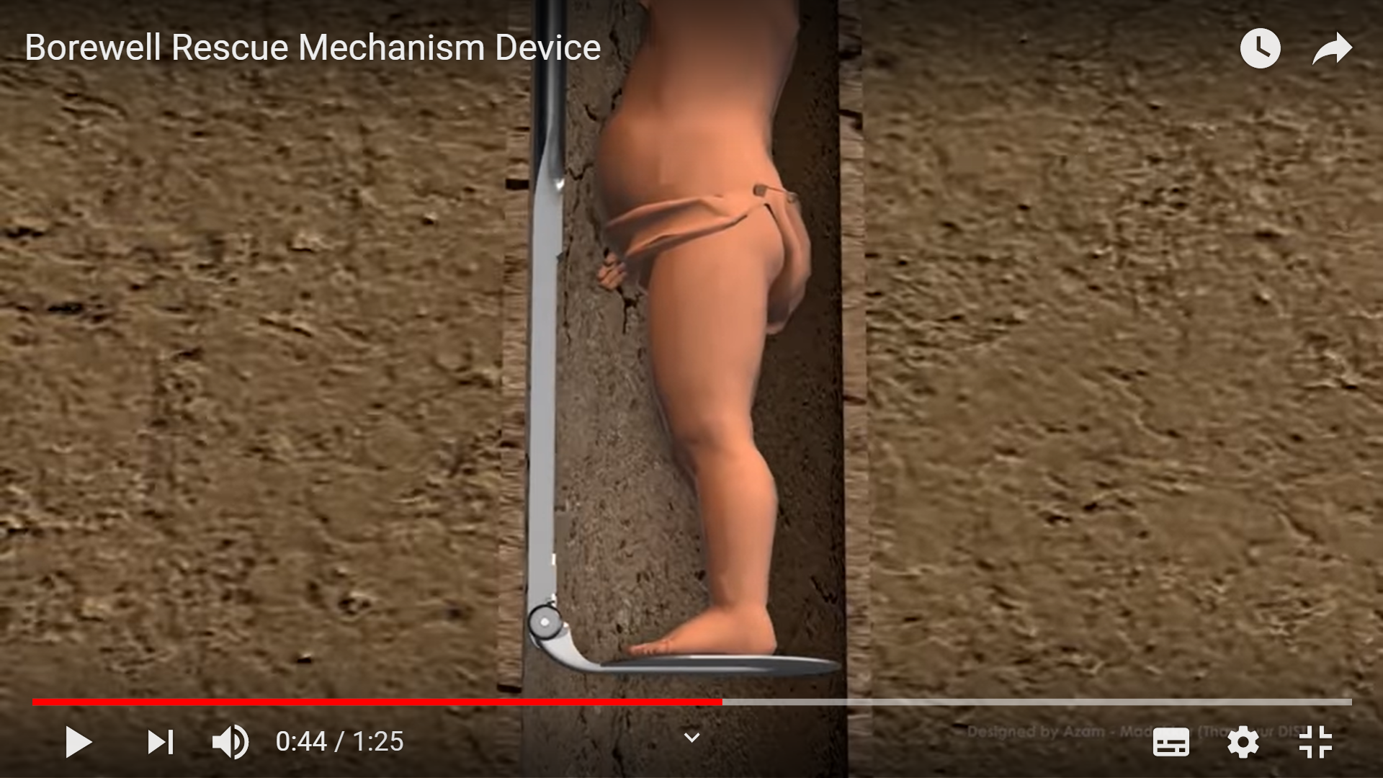
Surpassing Drawbacks:
Can handle upto 15kg with FOS 4.
Estimated rescue time is 4 hours.
Can penetrate into thickness as small as 6 inches.
Can probe upto 70 feet depth.
The head gripping structure ensures the child doesn’t slip.
Cage structure is made of stainless steel of high flexural rigidity so that it is highly prevented from bending during probe.
Lack of stable fixture might lead to the child slip along with holdings.
Cannot penetrate small thickness because of the voluminous structure

